Slide 1



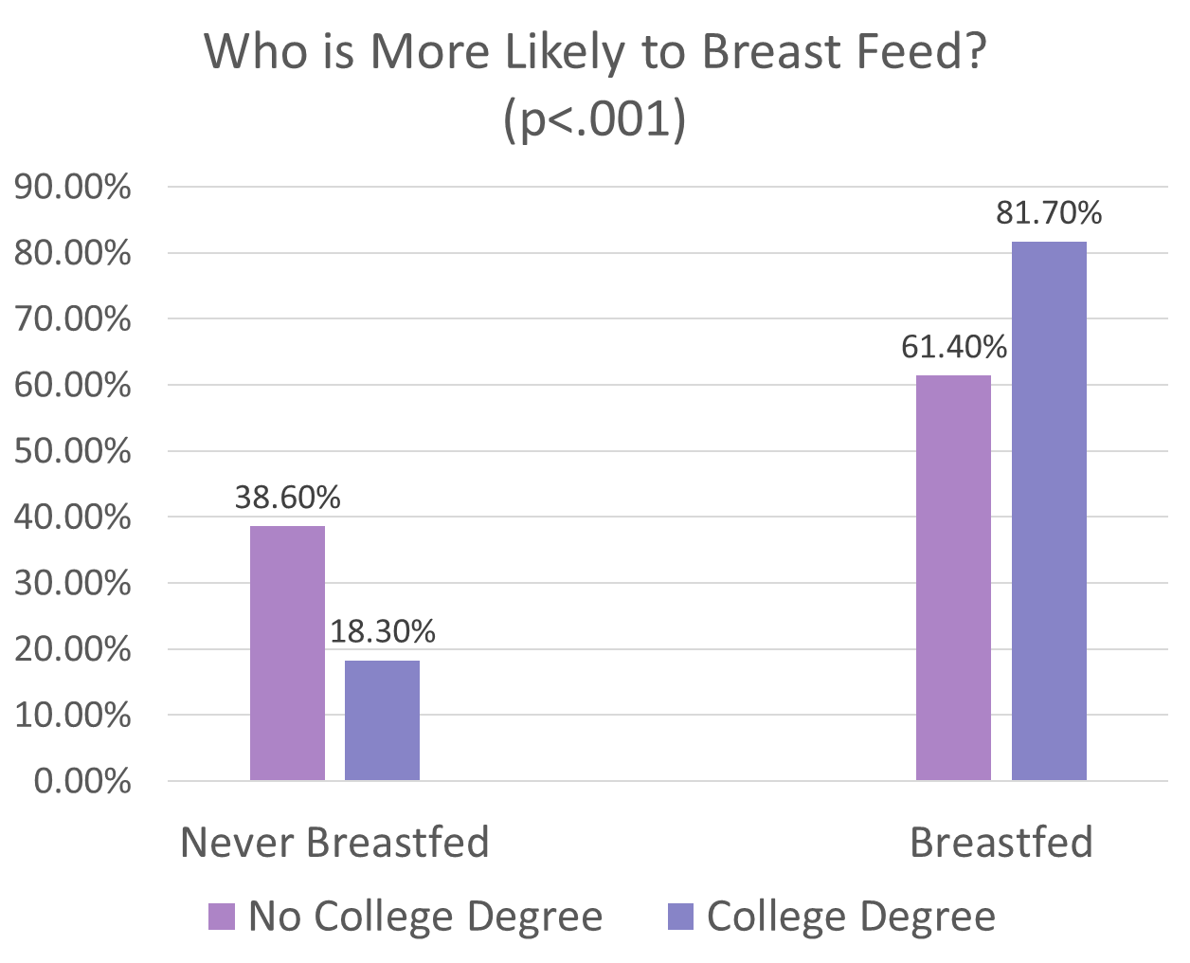
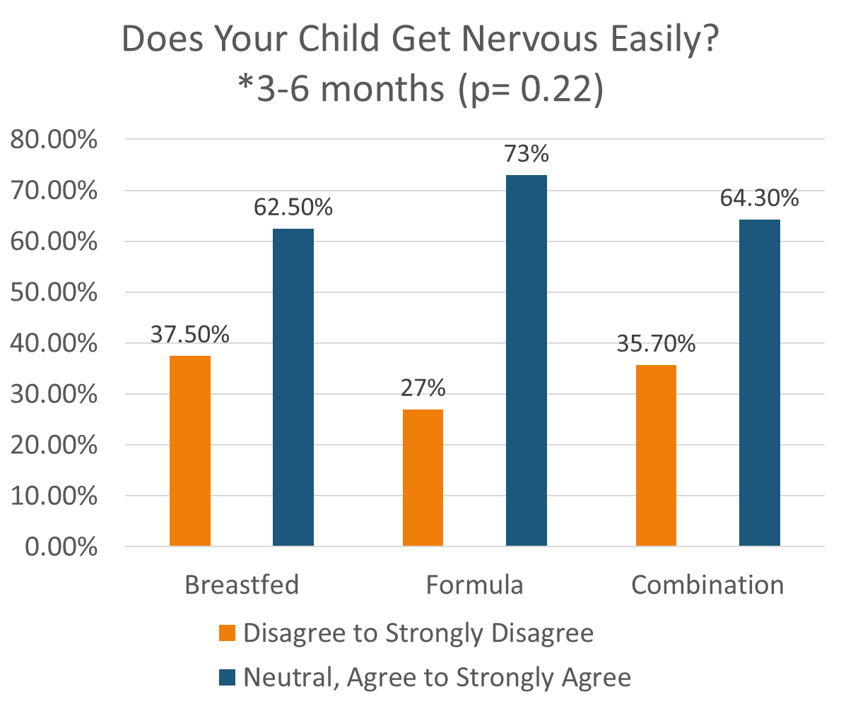
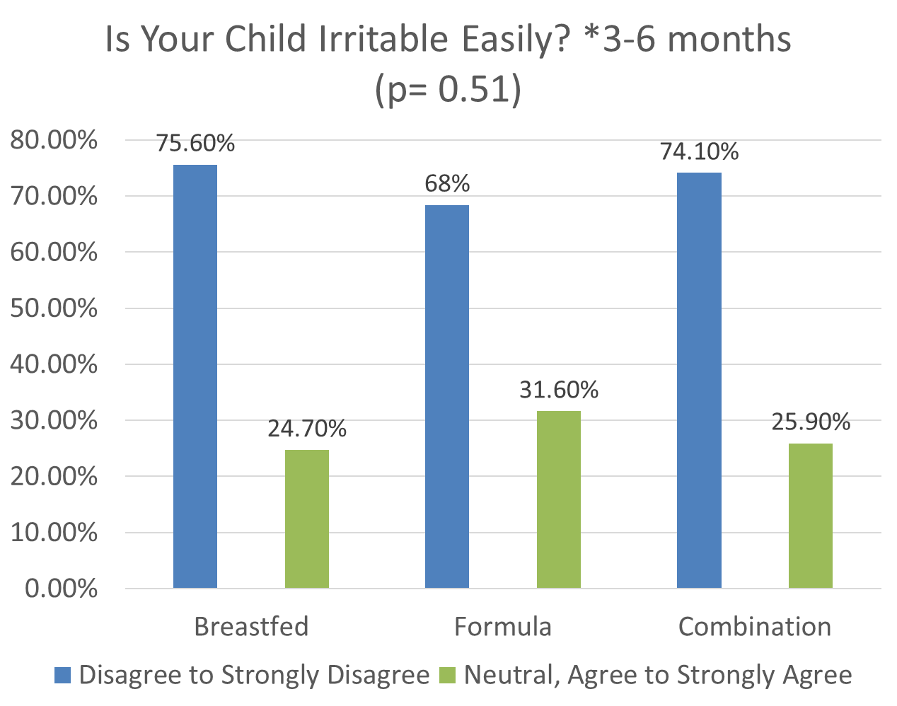





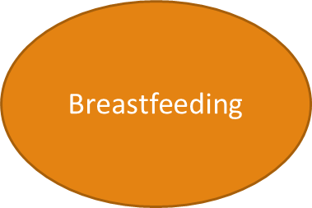

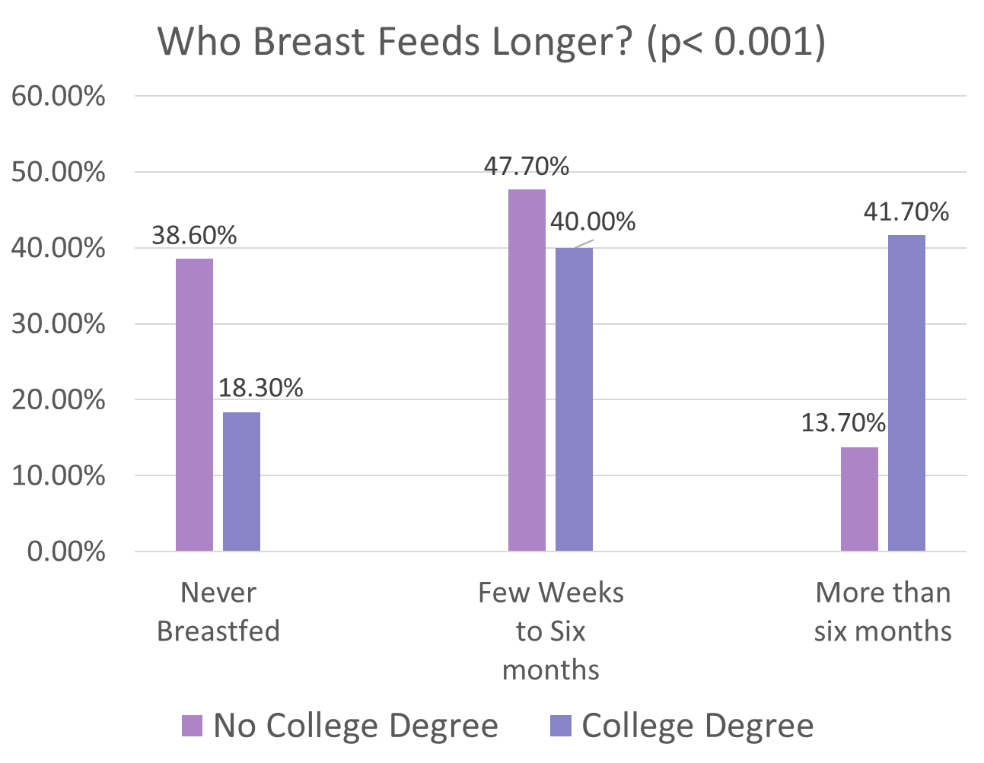
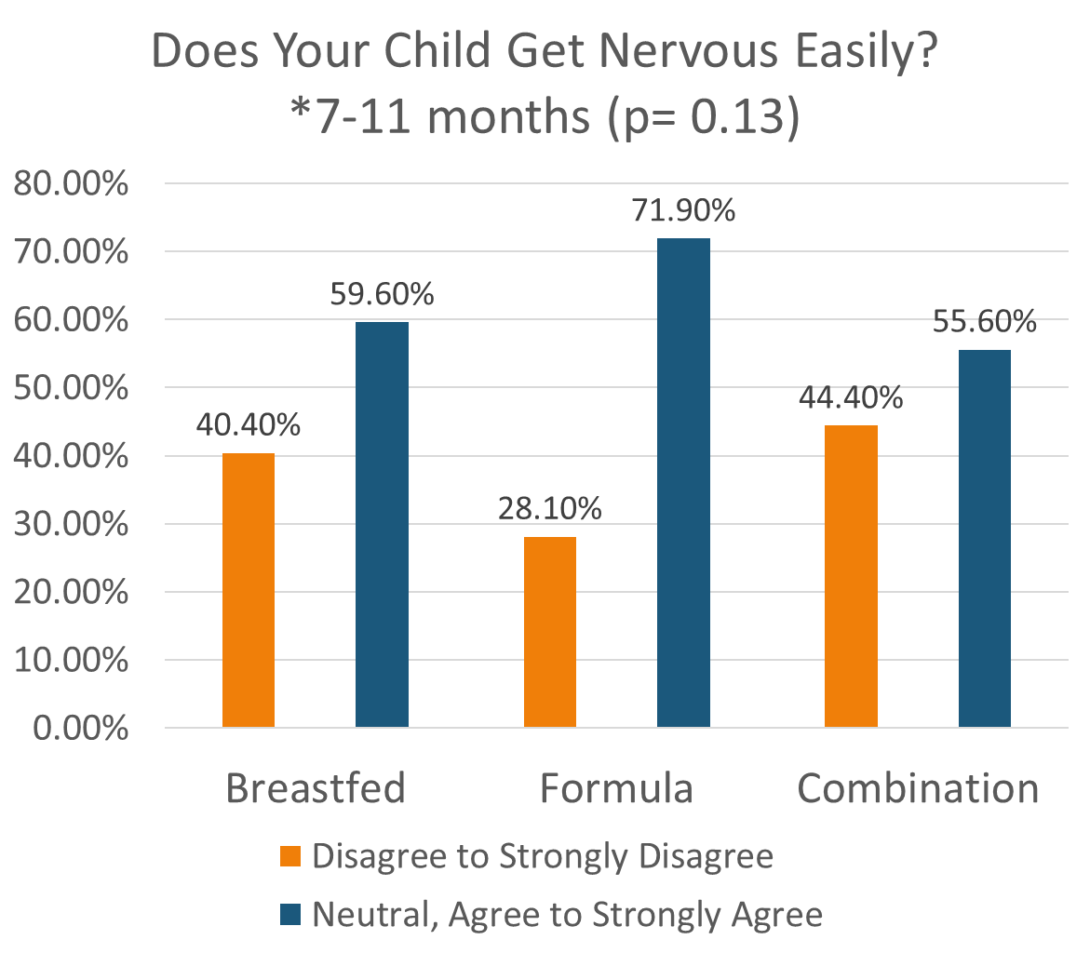





Breastfeeding and Social-Emotional Development of Kindergartners
Presented by Swellar Zhuo (William Smith’19)
Research Questions
Results for Question 1
Results for Question 2
Results for Question 3
Literature Review
Existing literature has suggested that a child’s social and emotional development may be influenced by the direct effects of breast milk and by the mother-infant interactions. Studies have found that the direct effects of specific nutrients in breast milk are responsible for the infant’s cortical brain development, which is associated with brain functions such as thought and action (Lauritzen et al. 2003). Other studies have supported that mothers who breastfeed displayed enhanced sensitivity towards their infants might promote and strengthen the infant’s bond with their parents/ caregivers (Britton et al. 2006). According to the World Health Organization, it is recommended that mothers, exclusively, breastfeed up to six months of age with continued breastfeeding along with appropriate complementary food up to two years of age or beyond (World Health Organization). Infants who were breastfed and breastfed for longer were found to be more secure than children who had never been breastfed (Tharner et al 2012). When looking at the duration of breastfeeding against the parent’s education level, mothers who were less educated, usually from lower income, breastfed for a shorter duration and would give their infant cow’s milk at 3 months of age (Belfort et al. 2013, Unmarino et al 2003).
Is there a relationship between parent’s highest education level and breastfeeding?
Is there a relationship between breastfeeding, exclusively, and a child’s social and emotional development?
*Pattern does not hold up for 7-11 months*
Is there a relationship between the duration of breastfeeding, exclusively, and a child’s social and emotional development?
Limitations and Future Research
Methods
Limitations:
Pace Survey
Future Research:
Do other confounding variables, like the family’s socioeconomic status, race and gender, influence the relationship between breastfeeding and the child’s social and emotional behavior?
Data collection: Supervised under Success for Geneva’s Children, the Geneva Parent Appraisal of Children Experience Survey (PACE) was distributed to parents and guardians of incoming years 2017 and 2018 who attended primary school in Geneva, New York.
The survey was designed to understand incoming kindergartners past childcare, health history, social and emotional functioning, fine and gross motor skills, early literacy insights and adverse childhood experiences (ACEs)
Sample: 276 Kindergartners
Study: Secondary data analysis on the PACE survey data
Measures for Independent Variables:
Parent with highest education level
“What was your child fed when he/ she was 3-6 months old?”
“What was your child fed when he/she was 7-11 months old?”
Measure for Dependent Variables:
“How long was she/he breastfed?”
“Does your child get nervous easily?”
“Is your child irritable, touchy or prickly?”
Theoretical Frameworks and Hypotheses
Cultural Distinctions: Lower education-level parents, typically from a working-class context, may have fewer financial resources, more environmental constraints, lower power and status, and fewer opportunities for control and choice.
Hypothesis 1: Lower educated-level mothers are less likely to breastfeed, exclusively, and for a shorter period compared to higher educated-level mothers.
Attachment Theory: Breastfeeding is a channel for breastfeeding mothers to understand their infant’s emotional state and respond accordingly to their infants needs. The skin to skin contact between the mother and the infant may help develop a strong relationship, and help infants form an emotional and physical connection to their mother, which would give them a sense of stability and security.
Hypothesis 2: Exclusively breastfed children will demonstrate healthier levels of social and emotional behavior.
Hypothesis 3: Longer breastfed children will demonstrate healthier levels of social and emotional behavior.
Conclusion
College degree mothers are more likely to breastfeed and for longer than six months. This relationship may exist because college degree mothers may have a higher socioeconomic status that affords positive environment factors, like paid maternity leave which allows them to breastfeed and to breastfeed for longer.
No college degree mothers are less likely to breastfeed and for a shorter duration of breastfeeding time. This relationship may exist because lower educated mothers may lack support by pediatricians, struggle with financial reasons and have reduced time available for infant care.
Breastfed children and breastfed children for more than six months are less likely to get nervous than non-breastfed children and non-breastfed children for more than six months. This might relate back to the attachment theory. Breastfed children and longer breastfed children may feel like they can rely on their parent as a source of comfort in times of stress.
Breastfed children are less likely to be irritable than non-breastfed children. This suggests that children who experience stronger secure infant attachment with their parent or caregiver might have lower levels of temperamental dependency, like clingness and fussiness.
References
Belfort MB, Rifas-Shiman SL, Kleinman KP, et al. Infant feeding and childhood cognition at ages 3 and 7 years: Effects of breastfeeding duration and exclusivity. JAMA Pediatrics. 2013;167(9):836–844.
Britton JR, J. (n.d.). Breastfeeding, sensitivity, and attachment. Pediatrics /, 118(5), 2208–2243./doi.org/info:doi/
Lauritzen L, Hansen HS, Jorgensen MH, et al. The essentiality of long chain n‐3 fatty acids in relation to development and function of the brain and retina. Prog Lipid Res 2001; 40 1–94.
Tharner A, Luijk MP, Raat H, et al. Breastfeeding and its relation to maternal sensitivity and infant attachment. J Dev Behav Pediatr. 2012;33(5):396–404.
Ummarino, M., Albano, F., De Marco, U., Mangani, S., Aceto, B., Ummarino, D., Guarino, A. (2003). Short duration of breastfeeding and early introduction of cow’s milk as a result of mothers’ low level of education. Acta Paediatrica. Supplement, 92(s441), 12..org/10.1080/08035320310018709
World Health Organization

