Slide 1


Our Promise
Is More than Shelter
Family Promise of Ontario County
2020 Annual Report

Slide 2

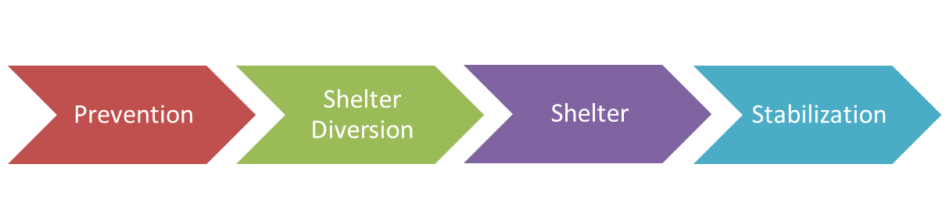
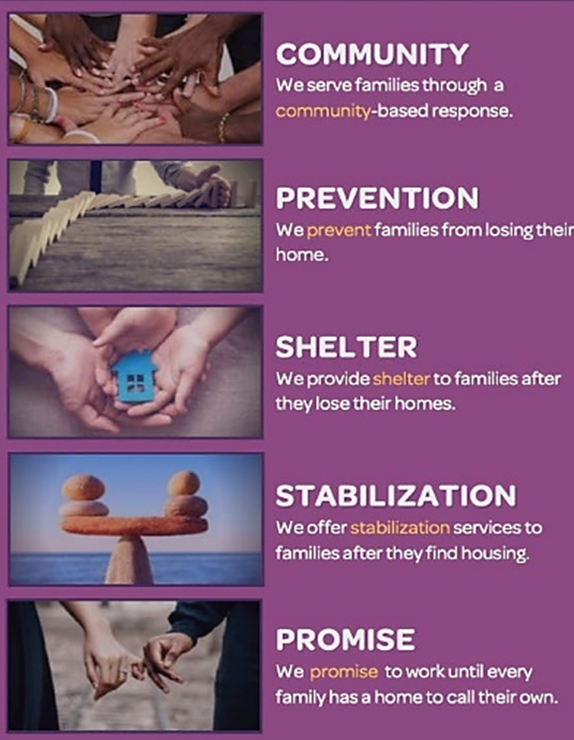
Family Promise Continuum of Care

Slide 3

Visualizing the Continuum
Stabilization
Prevention
Diversion
Rapid Rehousing
Shelter

Slide 4
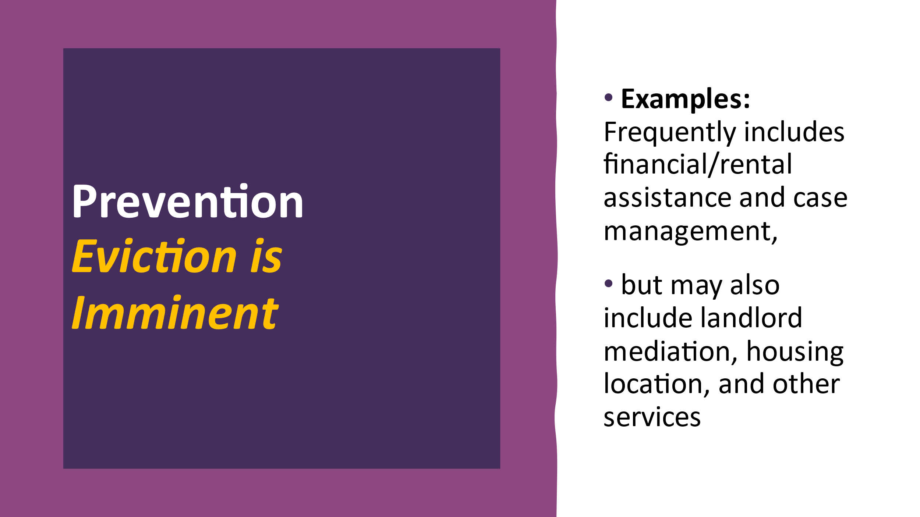
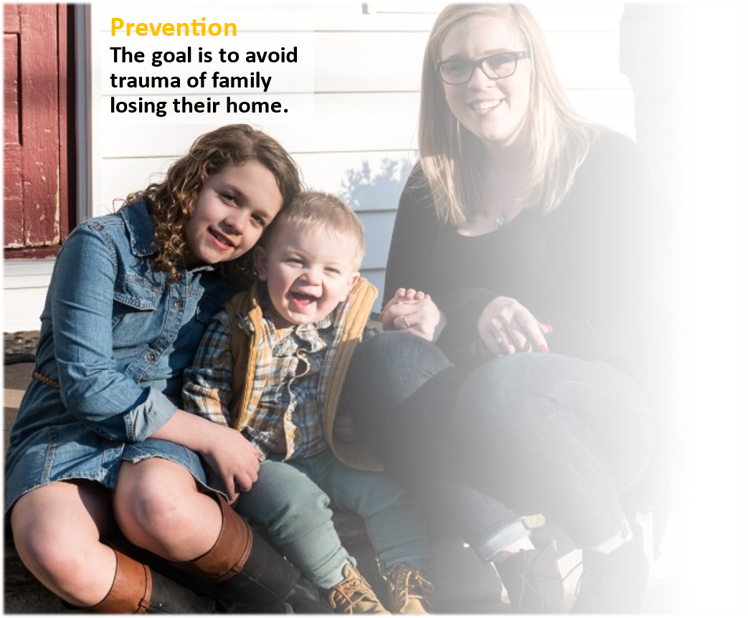
When Loss of housing is Imminent We Are There:
Helping families avoid eviction or foreclosure
Paying rent, rent arrears
Paying utility arrears
Case management to support the family post-eviction
Landlord relationship- mediation services
Security deposit and rent if needing to relocate

Slide 5

Diversion At Shelter’s Doorstep
Helping families think about their own resources, to avoid shelter: friends, family, paying for motel themselves
Saying "yes" to creative solutions
Payments for rent arrears, rent, utilities, security deposit
Landlord mediation and connections to establish housing for families
Intensive, fast case management to help families avoid entering shelter

Slide 6
Shelter Congregations, Apartments
Services Include:
Overnight accommodations
Food
Clothing- employment/interviews
Furniture
Transportation
Limited financial assistance
Case Management
Budgeting Class
Keys to Good Tenancy Program
Assistance locating housing & jobs
During the pandemic, Family Promise opened three emergency shelter apartments
in Canandaigua.
All rent and utilities to
stay in the program space in 2020 was covered by a grant from the Emergency Food and Shelter Program
In-Kind Donations of Meals, Volunteers, &
Accommodations in 2020 are valued, at: $168,364.

Slide 7


Stabilization
Post Shelter
Stabilization
Programming after shelter to help family units remain housed.
Graduate programs
financial capability program;
tenancy skills class; housing;
life skills class; workforce development;
health and wellness program.
Continued regular case management;
Rent & Utility Assistance
Secure Transportation

Slide 8


Community Services
Food pantry
furniture donation
summer camp
clothing closet
diaper donation
holiday gift program
Family units not served in other Family Promise Programs

Slide 9

Best Practices
Maintain trauma-informed care
Client-centered services
Say "yes" to creative solutions
Hospitality & empathy towards guests
Engage family members
Utilize case management
Lower barriers to services
Prioritize the safety of the family

