Slide 1



Community Eligibility Program:
Serving the Students of Geneva

Slide 2


How Did School Lunch Begin?
The National School Lunch Program was created in 1946 when President Truman signed the National School Lunch Act into law.
Reasons to support the new legislation include:
1. During physical examinations for military service in WWII, many young men were malnourished.
2. An outlet was needed for agricultural commodities produced by flourishing farms after WWII.
3. Lunch at school provided a better environment for learning to take place.

Slide 3

The National School Lunch Program is a federal nutrition assistance program operating in over 101,000 public and non-profit private schools and residential care institutions.
Regulated and administered at the federal level by the Food and Nutrition Service of the United States Department of Agriculture (USDA), it currently provides nutritionally balanced, low-cost or free lunches to more than 31 million U.S. children each school day.
Notes:
Talk about Regulated?

Slide 4

Facts About Child Nutrition Programs
School food programs in New York State are run as market driven, nonprofit operations.
Program funding is derived from reimbursement through Federal and State agencies.
  The School Nutrition Fund receives no financial support from the local school district.
Revenues must cover all costs; food, supplies, labor, fringe benefits, etc.

Slide 5

Healthy Hunger-Free Kids Act (HHFKA)
Created in 2010 and instituted in 2011 by President Obama the focus of HHFKA is to:
Combat the near epidemic growth of childhood obesity and health related issues in our Nation.
Offer children a nutritionally balanced meal.
Reduce obesity in younger military recruits.
This act is the biggest change to child nutrition this country has seen in over 30 years.

Slide 6
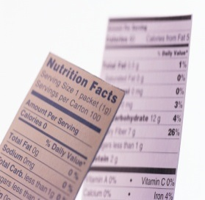
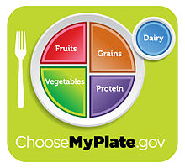
Nutritional Requirements
School lunches must meet the requirements of the Dietary Guidelines for Americans which include:
No more than 30% of an individual's calories come from Fat.
Less than 10% from Saturated Fat.
Provide 1/3 of the Recommended Dietary Allowances of:
  Protein
  Vitamin A
  Vitamin C
  Iron
  Calcium
  Calories
These requirements must be met over the course of 1 week's worth of lunches served.

Slide 7
Meals Served
85 % of students participate in school meals every day.
*Numbers and yearly projections are based on the October 2017 meal counts.
Breakfast
850 Daily
155,000+ per year
Lunch
1,708 Daily
294,000+ per year
After School Snack
240 Daily
57,000+ per year

Slide 8



Community Eligibility Program (CEP)
Geneva’s entire District is now enrolled in CEP!
Focus is on feeding students in schools that have a high free/reduced percentage for breakfast and lunch at no cost to the family.
Reimbursement rates from the USDA are based upon the percentage of students that are qualified for SNAP and Medicaid benefits.

Slide 9

Geneva City School District Statistics
2,189 Students Enrolled
2,196 Students Enrolled

Slide 10

Program Funding
Because of the Community Eligibility Program all students are able to eat for free during the 2017-2018 school year. Funding for the School Nutrition Program relies solely on State and Federal Aid. Reimbursement per meal is as follows:
Meal Federal State
Breakfast $1.9647 $.0963
Total $2.061/Meal
Lunch $ 3.105 $.0599
Total $3.1649/Meal

Slide 11
Revenue

Slide 12
Food Service Expenses

Slide 13

Call For Action
2008:
  Raising concern for feeding Children while not at school {weekends & school breaks}
  District reached out to FoodLink in Rochester
    December of 2008 distribution of weekend bags began
    144 bags were being distributed every 2 weeks
    FoodLink’s rule:
      Select families who qualify for Free meals
      Ask parents if they are interested in participation

Slide 14
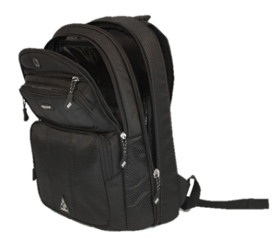
BackPack Program
2009 Increased distribution to 188 bags every 2 weeks
2013 funding for the FoodLink grant came to an end
  Forced to downsize program to 100 bags twice a month
  District used grant money that was available in addition to support from the community through:
    Staff fundraisers {wear jeans day}
    Hobart &William Smith Rowing & Lacrosse teams financial donations
    Seneca Foods Corporation: food donations

Slide 15

BackPack Program Sponsor
Geneva Rotary Club committed to sponsoring Geneva City School’s BackPack Program in 2016
  Donating $1,500 in that spring
  2016-2017 School Year donated $14,000
  2017-2018 School Year donated $12,000

Slide 16

Current Back Pack Program
Every 2 weeks we team up with FoodLink to provide 160 meal packs to needy children within Geneva Elementary Schools and Head Start.
The packs include a weekends worth of nutritious food at a cost of $4.40 per bag.

Slide 17
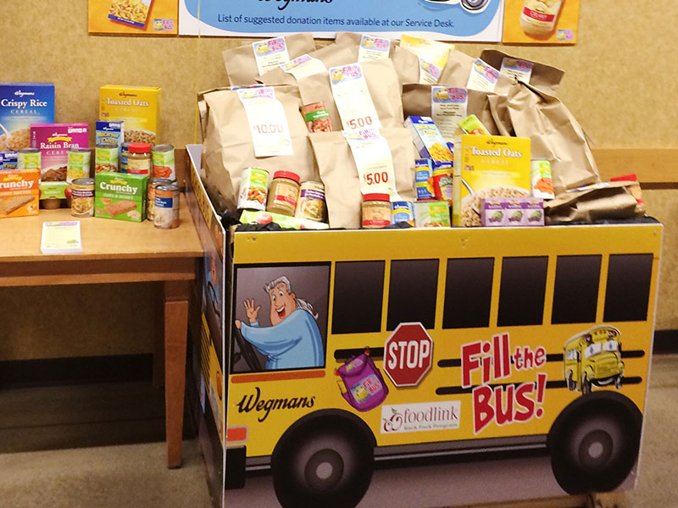

Wegmans Fill the Bus Campaign
Provides $600 of food/money to Geneva’s BackPack Program annually
Program benefits local area BackPack Programs run through FoodLink

